Slide 1

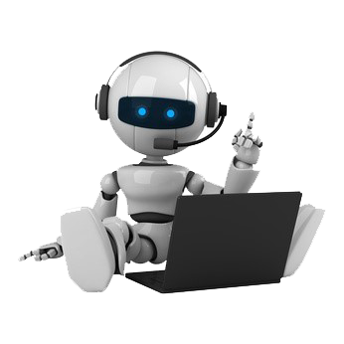
SUBMITTED BY:
JAGDISH SINGH
1513313040
IT-A

Slide 2
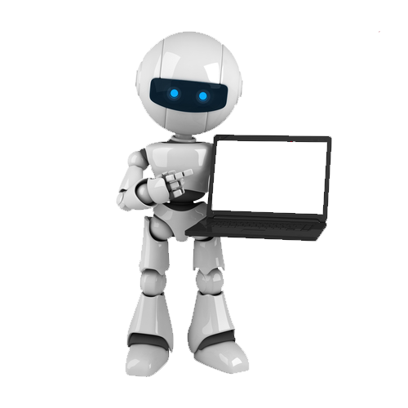
CONTENTS-
INTRODUCTION
A BOT IS NOT A ROBOT
HISTORY
WHY IS BOT SUCH A BIG DEAL?
TYPES
MAJOR COMPONENTS
HOW THEY WORK
DRIVEN BY MOBILE PLATFORMS
EVOLUTION OF BOTS MOVING FORWARD
WHAT BOTS CAN DO ?
APPLICATIONS
CONCLUSION
FUTURE SCOPE
REFERENCES

Slide 3
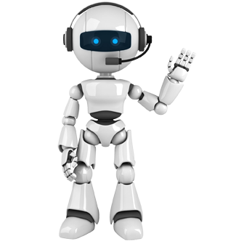
INTRODUCTION-
A bot is a software application that runs automated tasks (scripts) that are both simple and structurally repetitive, at a much higher rate than would be possible for a human alone.

Slide 4
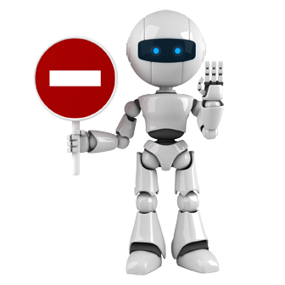
A BOT IS NOT A ROBOT !
While bots and robots both do the same thing, repetitive tasks human would do otherwise, bots are software and robots are mechanical.

Slide 5
HISTORY-
Bots have been around for more than 50 years. With the recent global boom in mobile messaging apps, such as WeChat, Facebook Messenger and Slack, they’re seen as increasingly relevant. They’ve likely been right under your nose. The first bots on Twitter starting rolling out in 2006.

Slide 6
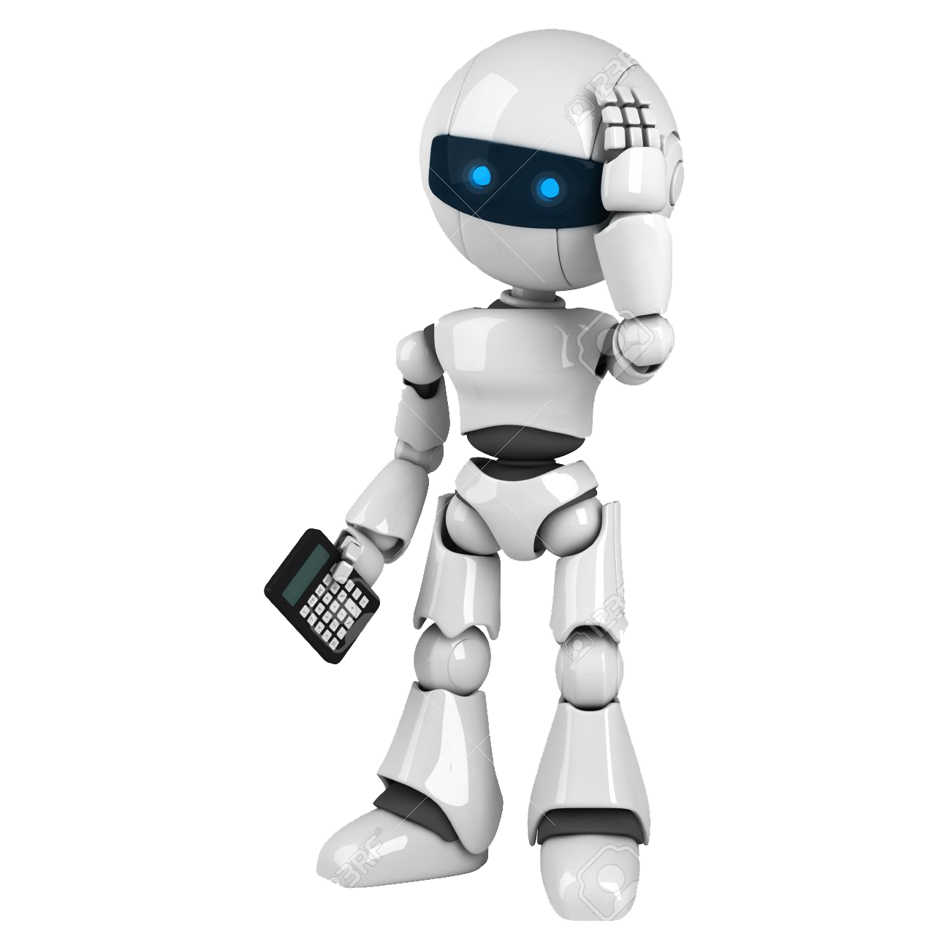
WHY IS BOT SUCH A BIG DEAL ?
App fatigue
Conversation as the interface
The raise of artificial intelligence

Slide 7
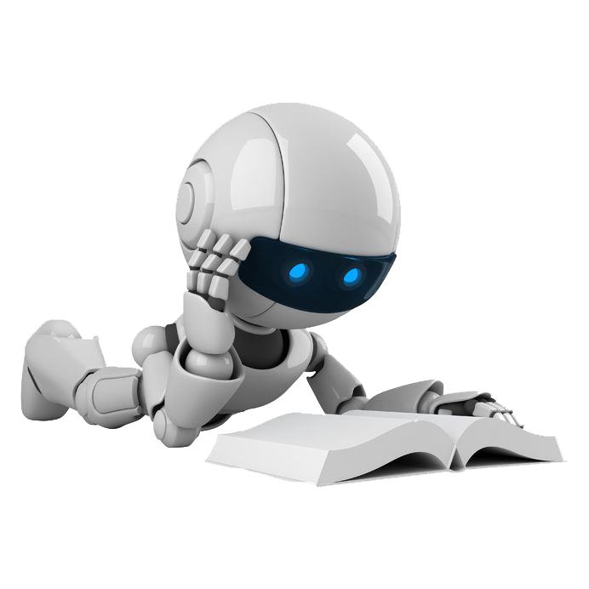
TYPES-
Stateless bots
Semi-Stateful bots
Stateful bots
Loyal bots

Slide 8
MAJOR COMPONENTS-
Development Platform
User Experience & Integration with Messaging Platforms
Artificial Intelligence Interface

Slide 9
HOW THEY WORK-
INPUT
CONVERSATIONAL PLATEFORM
OUTPUT
Semantic analysis
Context analysis
Answer engine

Slide 10






DRIVEN BY MOBILE PLATFORMS-

Slide 11
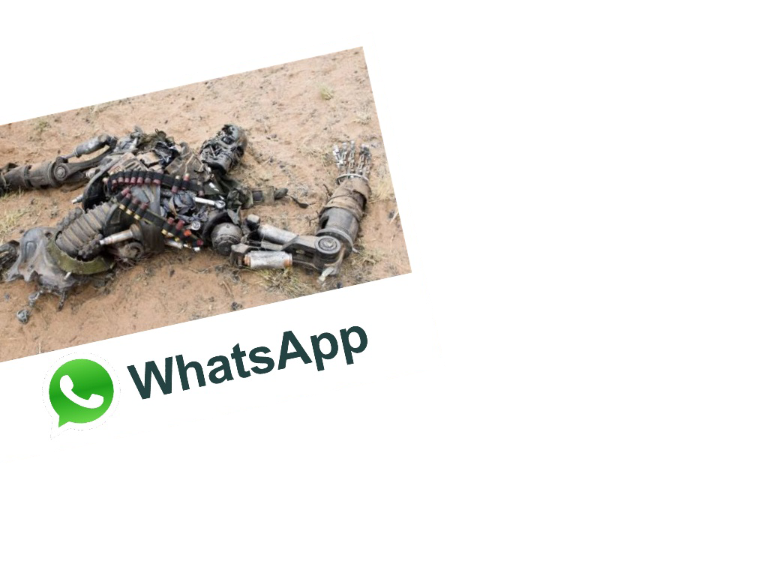
What about WhatsApp-
WhatsApp is the world’s #1 messenger with 1 billion users and it doesn’t even have messaging bots yet.
But even WhatsApp has declared already (Jan ‘16) that they will include business/brand communication option sooner than later.

Slide 12
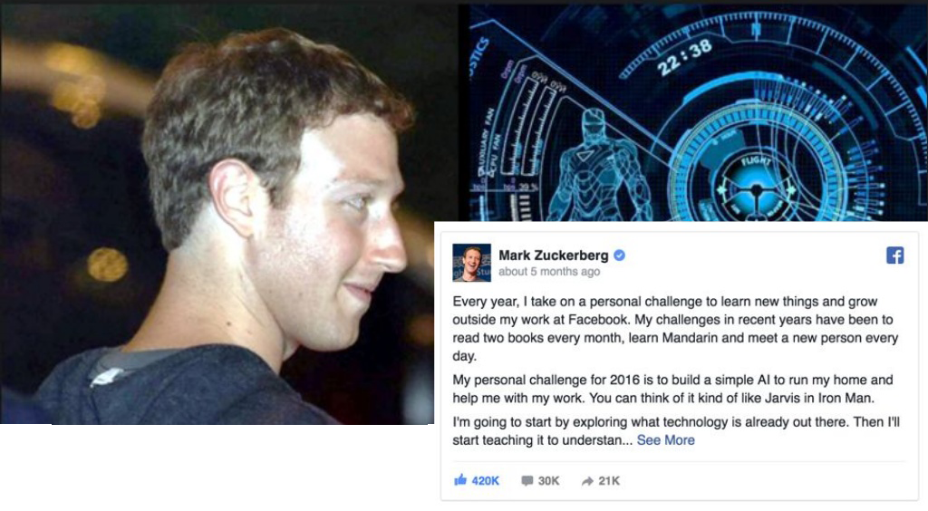
Mark Zuckerberg announces building his own “J.A.R.V.I.S”

Slide 13
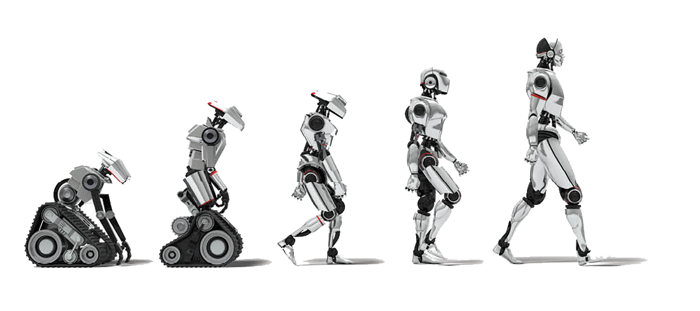
EVOLUTION OF BOTS MOVING FORWARD-
2015
Bots launch in First Social Plateform
2016
Bots Compatibility On all
Plateform
Next 18 Months
Users learn to adopt and use bots
Companies continues to develop bots.
2-5 Years from Now
Majority of daily mobile tasks become bot-assisted

Slide 14
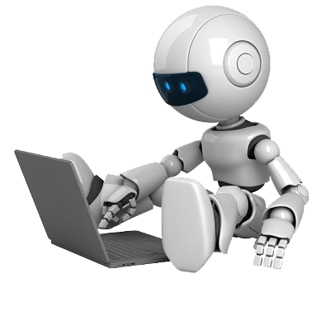
WHAT CAN BOTS DO ?
Content Distribution
Customer service
Business Process
Recommendation
Transaction

Slide 15
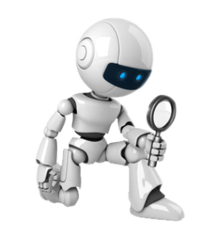
APPLICATIONS-
Access real time Infos
Shopping
Games
Search anything for you
Ordering things is so easy
Book a ride

Slide 16
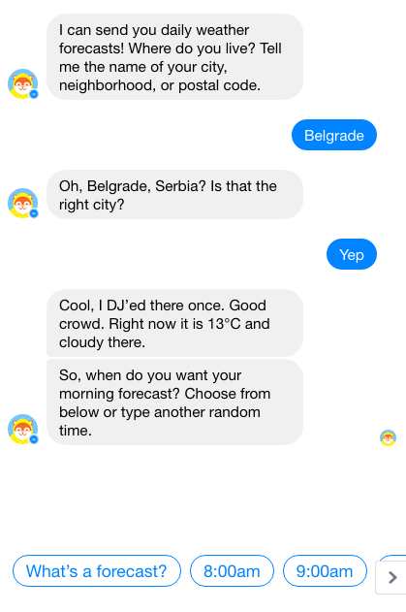
1). Access real time Infos

Slide 17
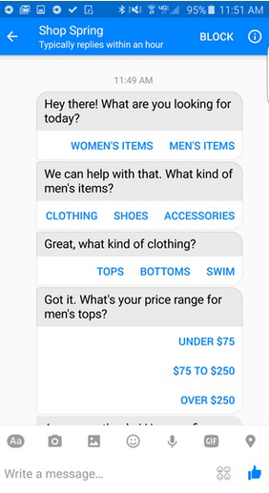
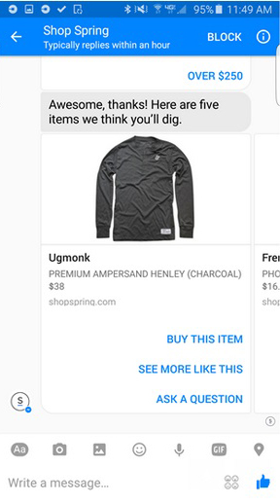
2). Shopping

Slide 18
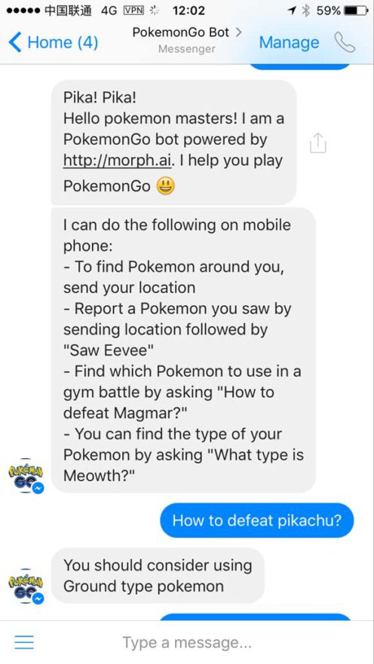
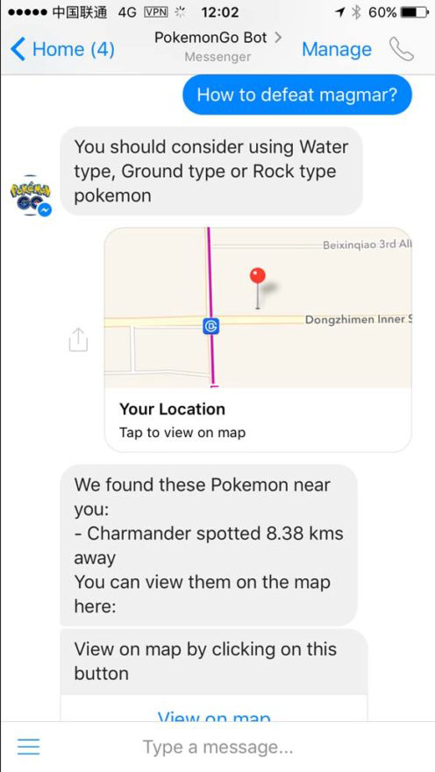
3). Games

Slide 19
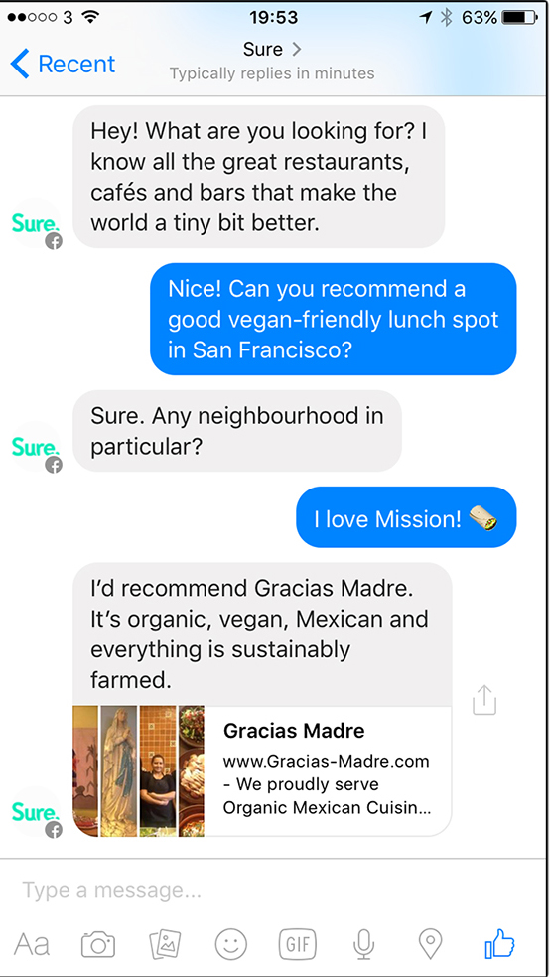
4). Search anything for you

Slide 20
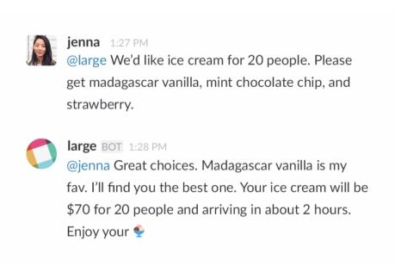
5). Ordering things is so easy

Slide 21
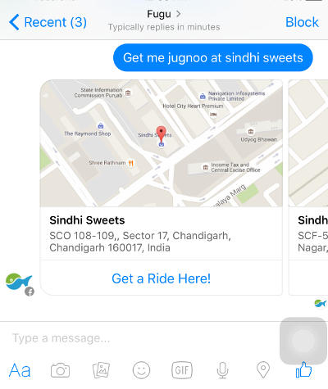
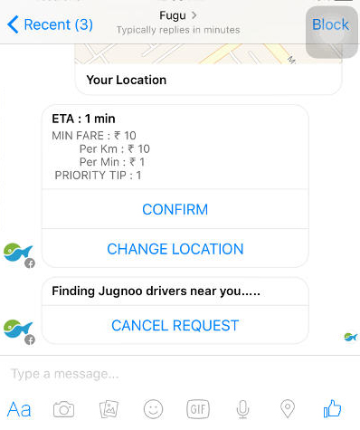
6). Book a ride

Slide 22
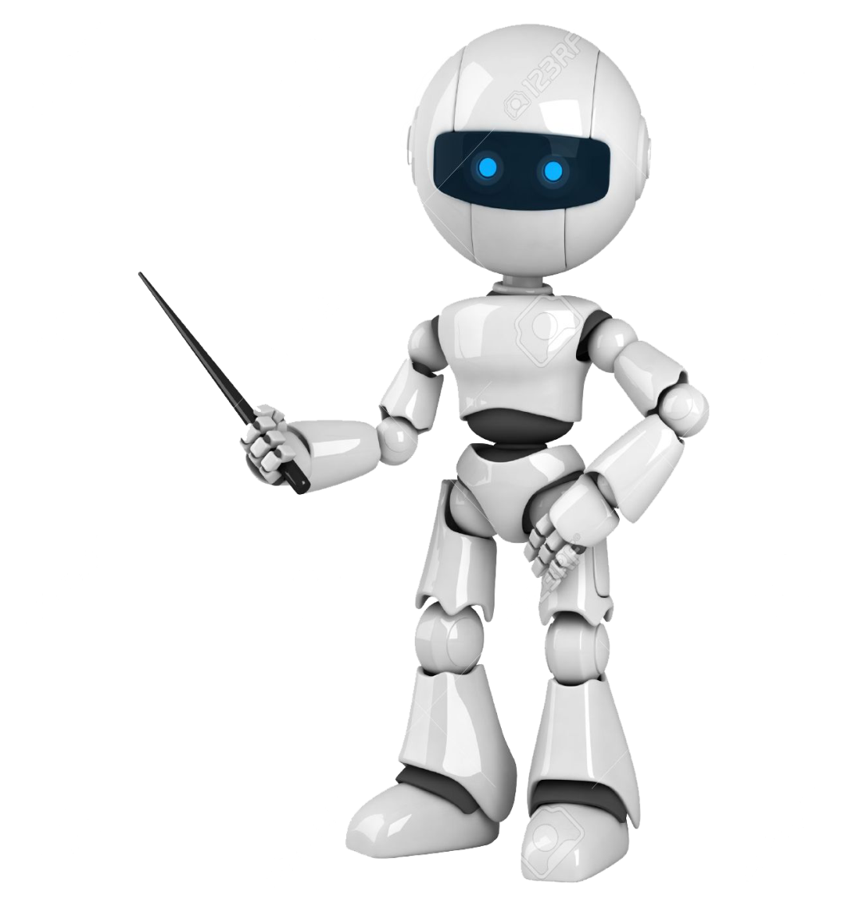
CONCLUSION-
BOTS are going to replace most of the apps and many programs needed in daily life and make our work easy.

Slide 23
FUTURE SCOPE-
E-COMMERCE
COMMUNITY
SOFTWARE
BOT OPPORTUNITIES :
LIMITLESS
INTERNET OF THINGS
ENTERTAINMENT

Slide 24
REFERENCES-
Tim Slavin ( April 2014) . “A Short History of Bots and Robots”.
Ramneek, Puri (2003-08-08). "Bots &; Botnet: An Overview" . SANS Institute.
A.L.I.C.E. Artificial Intelligence Foundation
ALICEBot
Alex Bunardzic (17 May 2016). ”Four Types of Bots”. Chatbots Magazine
Dunham, Ken; Melnick, Jim (2008). Malicious Bots: An Inside Look into the Cyber-Criminal Underground of the Internet. CRC Press. ISBN 9781420069068.
Holiday, Ryan. "Fake Traffic Means Real Paydays". BetaBeat.
von Lipinski, Percy (28 May 2013). "CNN's iReport hit hard by pay-per-view scandal". PulsePoint. Retrieved 21 July 2016.
Kurt Wagner (11 April 2016), “Bots, explained:What's the point? Or the business model?”. Recode.
Alan Mathison Turing (1950), “Computing Machinery And Intelligence”. Mind.
Spetka, Scott. "The TkWWW Robot: Beyond Browsing". NCSA. Archived from the original on 3 September 2004. Retrieved 21 November 2010.
E. G. Coffman Jr; Zhen Liu; Richard R. Weber (1998). "Optimal robot scheduling for Web search engines". Journal of Scheduling. 1 (1): 15–29. doi:10.1002/(SICI)1099-1425(199806)1:1<15::AID-JOS3>3.0.CO;2-K.

Slide 25
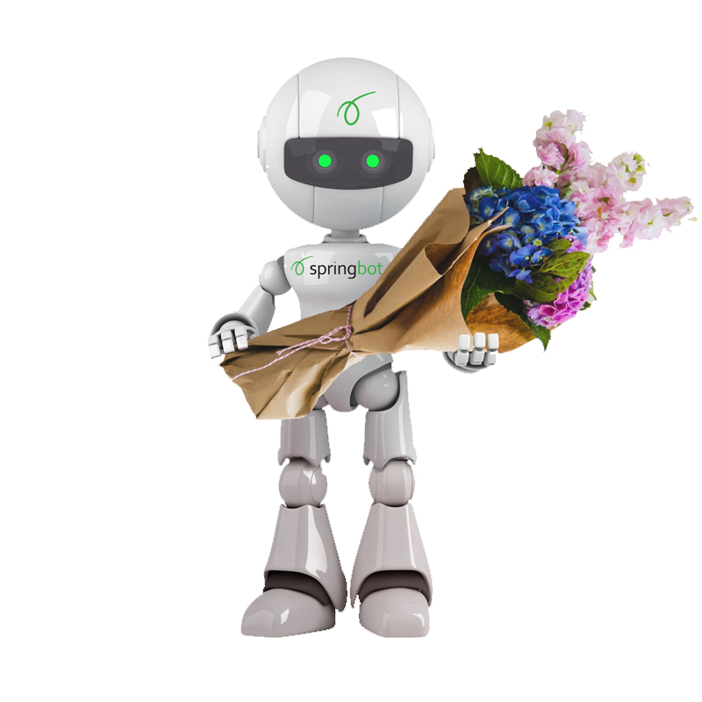
THANK YOU

Slide 26
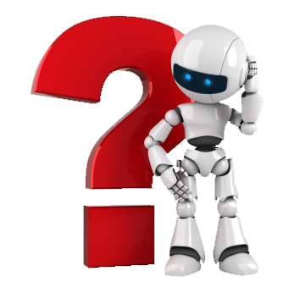
QUERIES ?

